Slide 1
Basic Stochastic Models Chapter 4
CS 637, St. Elizabeth's University, Fall 2021

Slide 2
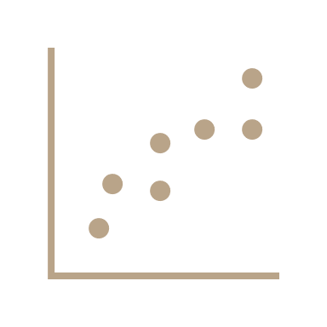

Basic Stochastic Models
Two types of modeling thus far
The first assumes that there is a fixed seasonal pattern about a trend
The second approach allows the seasonal variation and trend, described in terms of a level and slope, to change over time and estimates these features by exponentially weighted averages

Slide 3
Basic Stochastic Models
When we build predictions from a model, the difference between the predictions and actual realizations of the values is called the residual error series
residual

Slide 4
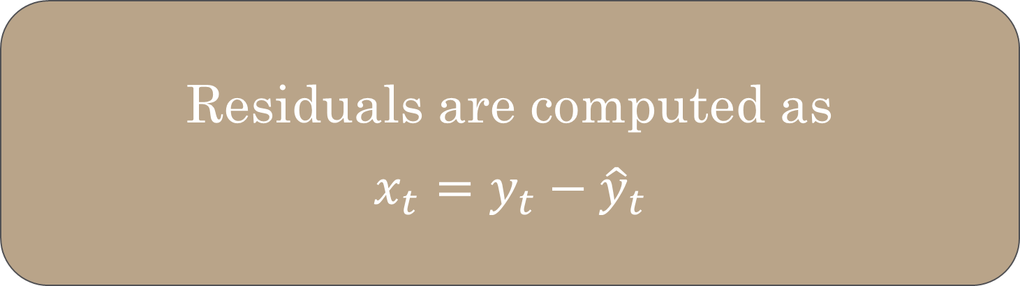
Basic Stochastic Models
These residual errors should be random variables from some probability distribution
However, we do often see structure in these residuals (something like auto correlation, for example)
We can leverage this property to improve forecasting
Residuals are computed as $$x_{t}=y_{t}−{\hat{y}}_{t}$$

Slide 5
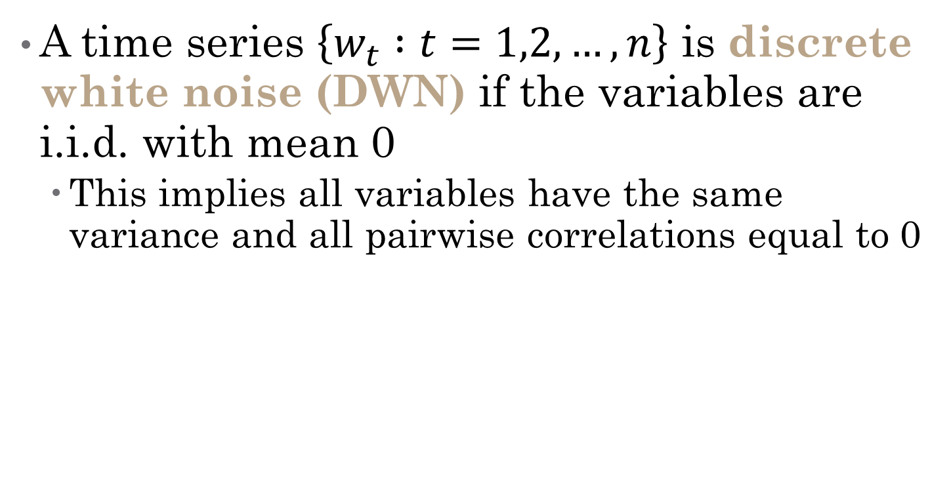
Basic Stochastic Models
A time series $\left\{w_{t} :t=1,2,…,n\right\}$ is discrete white noise (DWN) if the variables are i.i.d. with mean 0
This implies all variables have the same variance and all pairwise correlations equal to 0

Slide 6
Lecture 4.RMarkdown
Forecasting Strategies

Slide 7
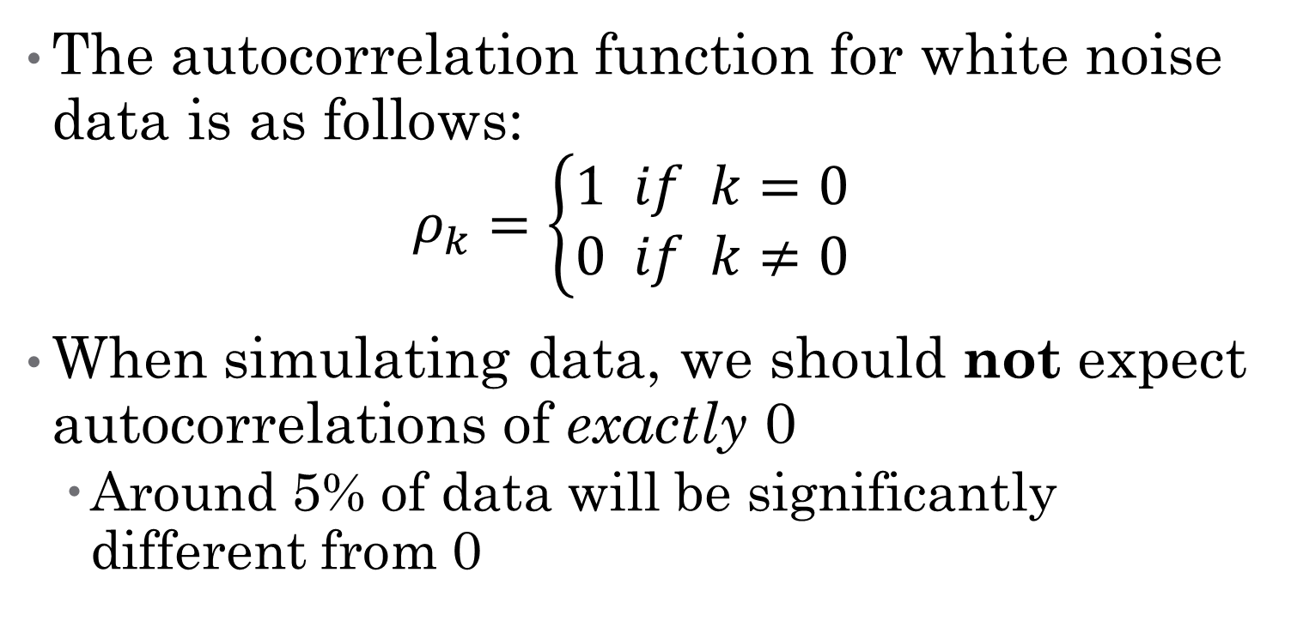
Basic Stochastic Models
The autocorrelation function for white noise data is as follows: $ρ_{k}=\left\{\begin{aligned}1 if k=0 \\ 0 if k≠0\end{aligned}\right.$
When simulating data, we should not expect autocorrelations of exactly 0
Around 5% of data will be significantly different from 0

Slide 8
Lecture 4.RMarkdown
Forecasting Strategies

Slide 9
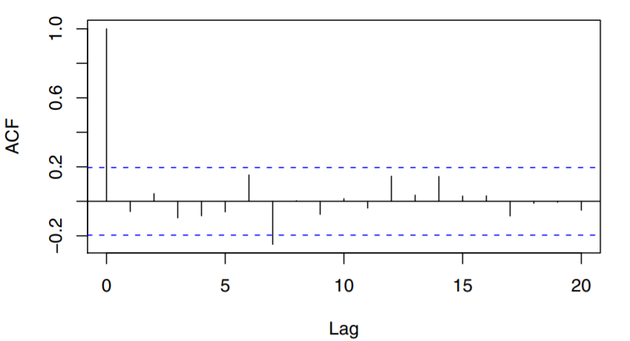
Basic Stochastic Models
When simulating data, we should not expect autocorrelations of exactly 0
Around 5% of data will be significantly different from 0
The statistically significant value at lag 7 is due
to sampling variation

Slide 10
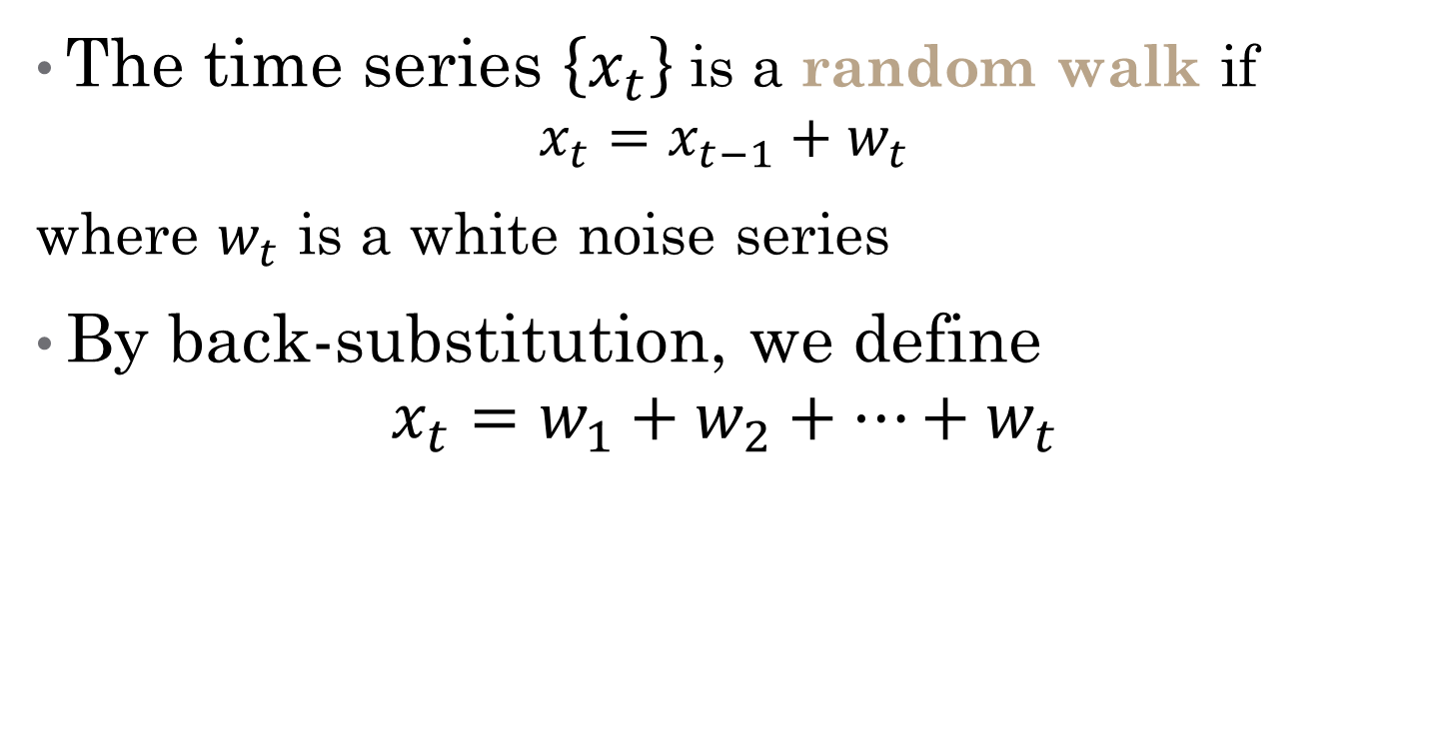
Random Walks
The time series $\left\{x_{t}\right\}$ is a random walk if $x_{t}=x_{t−1}+w_{t}$
where $w_{t}$ is a white noise series
By back-substitution, we define $x_{t}=w_{1}+w_{2}+…+w_{t}$

Slide 11
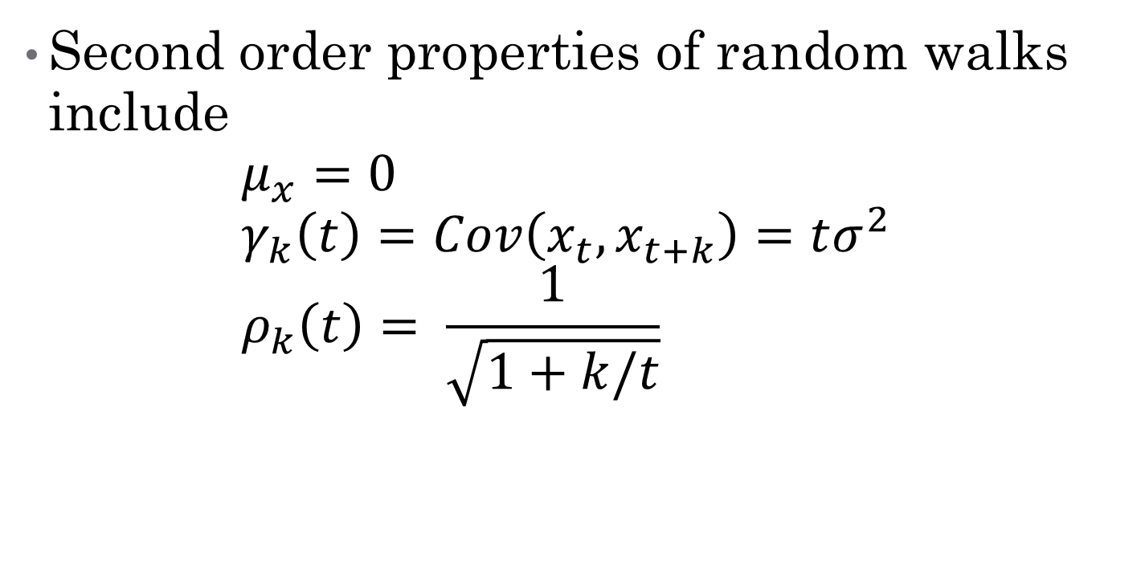
Random Walks
Second order properties of random walks include $μ_{x}=0$ $γ_{k}\left(t\right)=Cov\left(x_{t},x_{t+k}\right)=tσ^{2}$ $ρ_{k}\left(t\right)= \frac{1}{\sqrt{1+k/t}}$

Slide 12
Lecture 4.RMarkdown
Forecasting Strategies

Slide 13
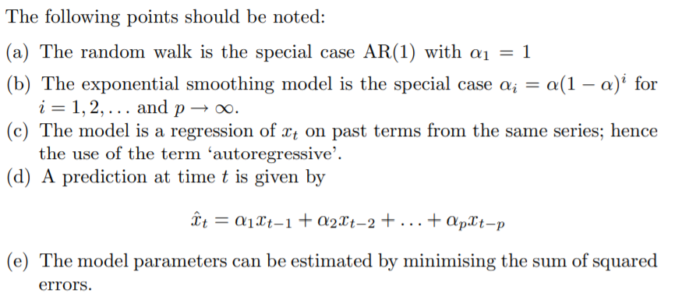

Autoregressive Models
The series $\left\{x_{t}\right\}$ is autoregressive of order p AR(p) if $x_{t}={α_{1}x}_{t−1}+{α_{2}x}_{t−2}+…+{α_{p}x}_{t−p}+w_{t}$

Slide 14
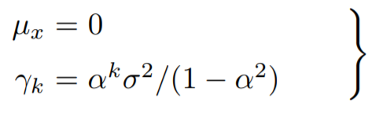

Autoregressive Models
The series $\left\{x_{t}\right\}$ is autoregressive of order p AR(p) if $x_{t}={α_{1}x}_{t−1}+{α_{2}x}_{t−2}+…+{α_{p}x}_{t−p}+w_{t}$

Slide 15
Lecture 4.RMarkdown
Forecasting Strategies

